Slide 1
Supervisor : Prof. Aritri Debnath
CREDIT RISK ANALYSIS :
Analyzing Loan Approval
Presenter :
Gboyega Adenaike

Slide 2

About Me:
Name: Gboyega Adenaike
Contact: segedenny56@gmail.com
LinkedIn profile: linkedin.com/in/gboyega-adenaike-860b0644
SKILLS
Data Analysis Tools: Excel, SQL, Python (Pandas, Numpy)
Data Visualization: Excel, Power BI, Matplotlib, seaborn
Predictive Modeling
Machine Learning: scikit learn, linear regression, clustering, deep learning algorithm
Report writing
Critical thinking, communication, problem – solving, teamwork
AREA OF INTEREST:
Data Analyst
Business Analyst
Data Science

Slide 3
Overview
Introduction
Project Description
Data Description
Data Cleaning & Quality Assessment
Description of TARGET variables
Univariate Analysis
Bivariate Analysis
Multivariate Analysis
Recommendations
Conclusion
Appreciation

Slide 4
Introduction:
This project applies Exploratory Data Analysis (EDA) to financial risk analytics, aiming to identify key indicators of loan default.
By leveraging data-driven insights, financial institutions can optimize loan approvals, implement risk-based interest rates, and refine credit limits .
Understanding the driving factors behind defaults enhances portfolio management and risk assessment, ensuring fair lending decisions while minimizing financial losses.
This study highlights the power of EDA in strengthening risk management frameworks and improving overall credit portfolio performance.

Slide 5
Project Description:
This Project aims to identify patterns which indicate if a client has difficulty paying their installments which may be used for taking actions such as denying the loan, reducing the amount of loan, lending (to risky applicants) at a higher interest rate, etc.
This will ensure that the consumers capable of repaying the loan are not rejected. Identification of such applicant's using EDA is the aim of this case study. In other words, the company wants to understand the driving factors (or driver variables) behind loan default, i.e., the variables which are strong indicators of default. The company can utilize this knowledge for its portfolio and risk assessment.

Slide 6
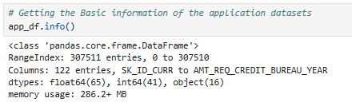
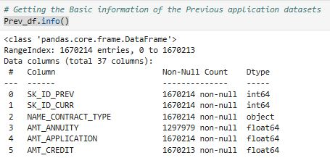

Data Description:
This project will be exploring two major datasets, current and previous datasets.
The application dataset, which contain 307,511 numbers of rows and 122 features or columns while we have 1,670,214 numbers of rows and 37 features or columns for the previous applicated datasets.
The application Datasets is described as the current loan for each clients while the Previous application is the old or former loan application of clients.
The information of the application datasets for the loan shows that we have SK_ID_CURR column as the first one and having AMT_REQ_CREDIT_BUREAU_YEAR as the last columns while we have 65 columns as float, 41 columns as integers and 16 columns as object type of datasets.
The information of the previous application datasets for the loan shows that we have SK_ID_PREV column as the first one and having NFLAG_INSURED_ON_APPROVAL as the last columns while we have 15 columns as float, 6 columns as integers and 16 columns as object type of datasets with the count of records having non-null in the columns.

Slide 7
Data Cleaning & Quality Assessment:
Data Cleaning and Preparation: Checking for missing values by column and row wise, Made a summary statistics of columns, Removed columns of high percentage of null values that are not impacting the quality of the analysis
Perform imputation techniques : Datasets was visualized using boxplot and replace null values with mean, median or mode. Datatypes were standardized and text field was maintained to avoid inconsistency.
Identify outliers:
Outliers were identified in both Numerical and categorical columns
Data quality Assessment: DQA was performed on all records to ensure duplicates are removed, outliers are improved and at the end the datasets were perfect for analysis.
Exploratory Data Analysis (EDA): Datasets was visualized, and analysis was carried out to extract insights and key indicators for loan approval.

Slide 8
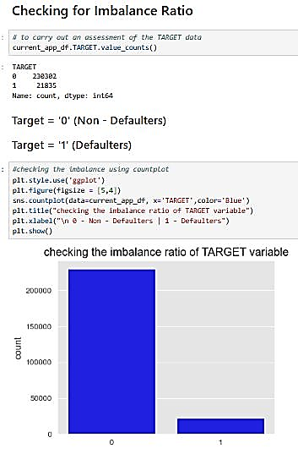
Description of TARGET variable for Analysis:
TARGET variable:
The target variable column contains the data that help to identify defaulters and non- defaulters. Defaulters are clients that have difficulties in repaying their loan while Non- defaulter are clients that make payments of their load on time.
Checking for imbalance:
I carried out check to see if imbalance exist in the column, we can also see that there are over 80% of Non-Defaulters.
Our focus is on the Target Variable as it identify both the defaulters and Non- defaulter for conducting univariate, Bivariate and multivariate analysis.

Slide 9
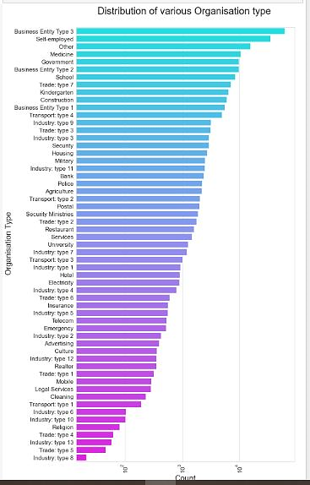
Performing Univariate Analysis
I perform analysis on single columns to draw insights from it by Plotting a bar chart for Non- defaulters in re-paying their loan i.e. The Target = 0 Clients:
Clients which have applied for credits are from most of the organization type 'Business entity Type 3', 'Self employed', 'Other', 'Medicine' and 'Government’.
Less Clients are from industry type 8, type 6, type 6, type 10, religion and trade type 5, type 43. same as type 0 in distribution of organization type.

Slide 10
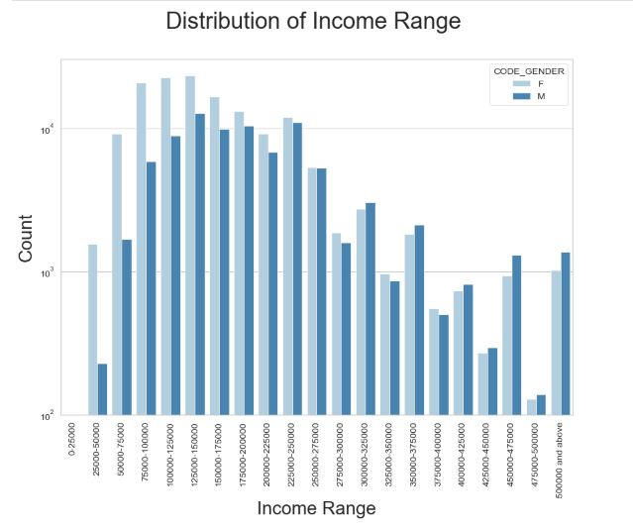
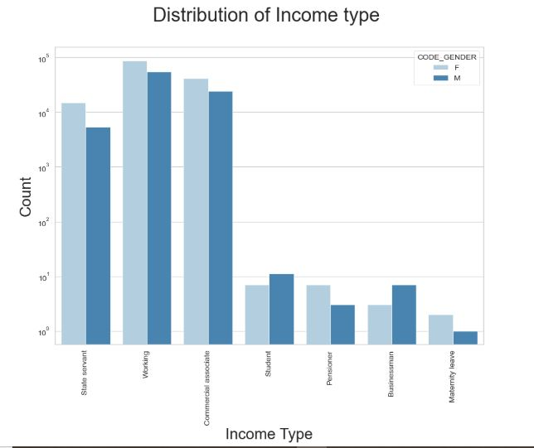
Insights:
From the analysis the income of Female is more than the male, this is a strong indication that female will be considered for loan approval and won't be a defaulter.
State servant, working class and commercial association have higher income but female still possess high income earing than male.
Non –defaulters are high in state servant, working class and Commercial Association, this be because they earn higher and have a reasonable income than students and pensioners.

Slide 11
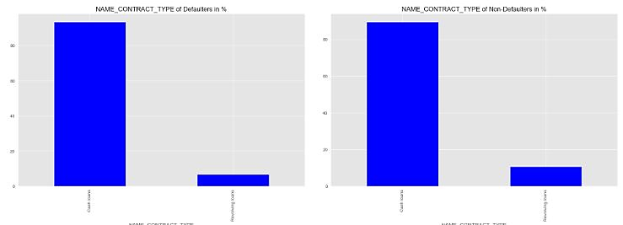
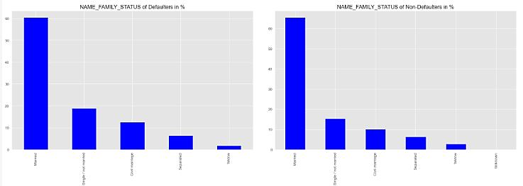
Insights:
Clients with higher Education are Non-Defaulters than other maybe due to weak correlation of records
clients who are Married or Window are Non-Defaulters but clients who are students or Not Married are defaulters
Among Defaulters: 59.8% are married, 3.8% are widow, and the rest are either single or Not Married.

Slide 12
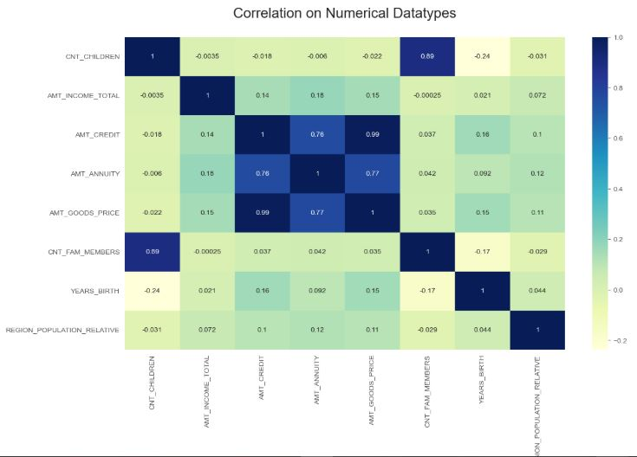
Insights:
The amount of credit of a client is highly correlated with the Annuity about 76% which means that annuity is likely to increase if payment of loan is not on time.
The price of Good have 99% chances of increasing your habit of spending which may allow you to have higher credit to pay.
Family members also increase the chances of being rejected for loan application, meaning if you have more children with the bills and monthly expenses it will affect you r chances of loan approval.

Slide 13
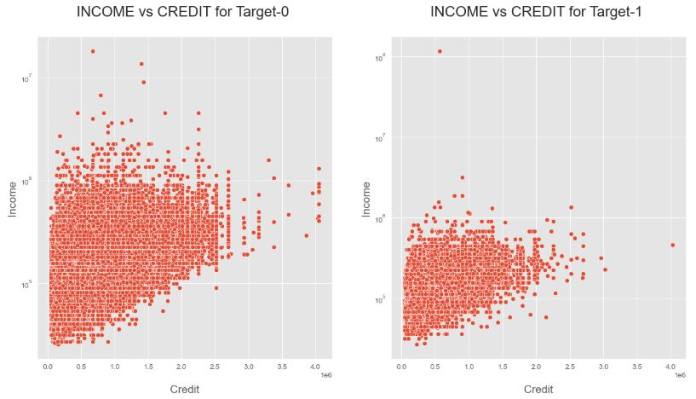
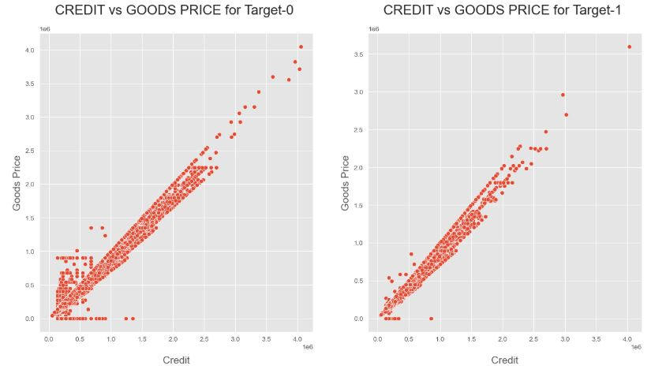
Bivariate Analysis
With the scatter plot we can determine that AMT_CREDIT and AMT_GOODS_PRICE are highly correlated which means that if increase in goods price the credit increased directly and vice versa.
Non- Defaulters have higher correlation with their income as they have strong advantage of Loan approval than defaulters.
High income rate among Non-defaulter show a high credit score and financial discipline.

Slide 14
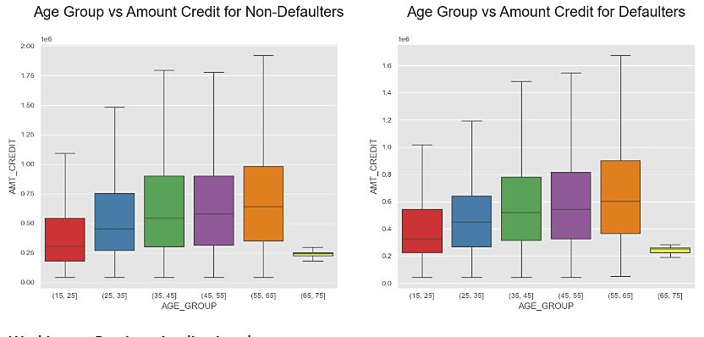
Bivariate Analysis
According to the analysis shown on the boxplot, we can not that age group 35-45 and 45-55 and 55-65 are non-defaulters in repaying their loans.
Age group 65 -75 has very low variables in the data, so we may not be able to justify their credibility according to the records.
High defaulters can be found in age group 55 -65 and 45-55.
Due to less approval of loan in the Bank Age group 15-25 will not to be considered for loan.

Slide 15
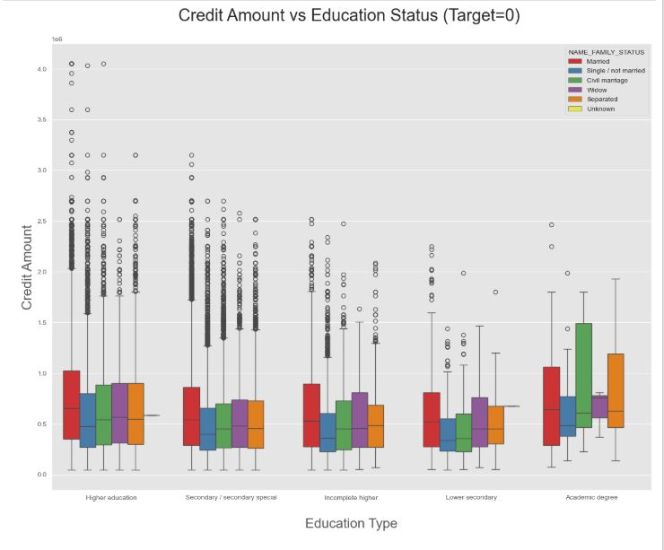
Multivariate Analysis
From the above box plot we can conclude that Family status of 'Civil Manager', 'Manager' and ‘Separated' of Academic Degree education are having higher number of Credits than others.
Higher Education of family status of 'Marriage', 'Single' and 'Civil Marriage' are having more outliers.
Civil Marriage for Academic degree is having most of the credits in the third quartile.

Slide 16
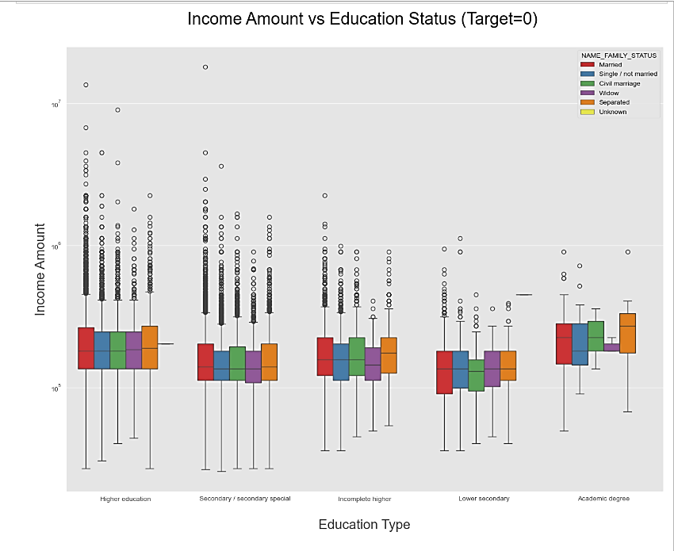
Multivariate Analysis
Looking at the Education Type, Higher Education- the income amount is mostly equal with family status, it does contain outliers.
Academic degree income amount is little higher compared to Higher Education.
Lower secondary of civil marriage family status have less amount than others.

Slide 17
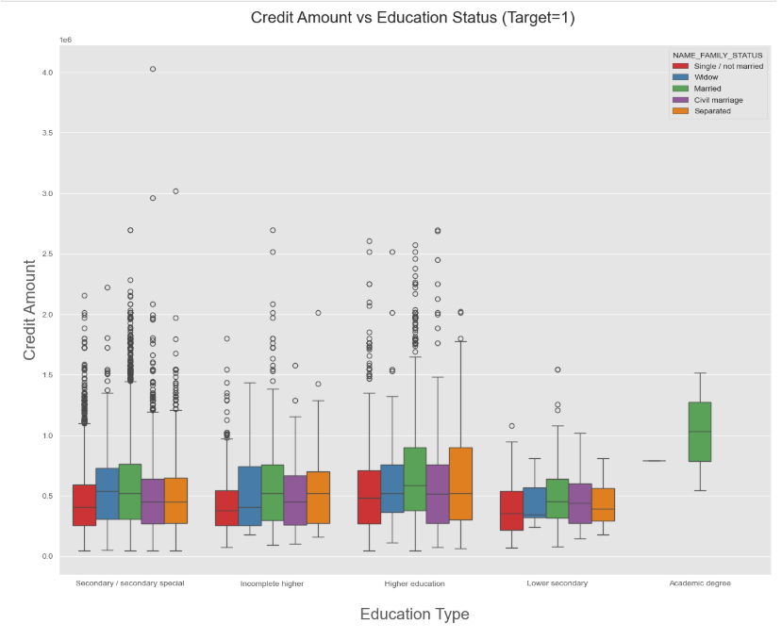
Multivariate Analysis
Looking at the Education Type, Higher Education- the income amount is mostly equal with family status, less contain outliers for Academic degree.
Academic degree income amount is little higher compared to Higher Education.
Lower secondary have less amount than others.

Slide 18
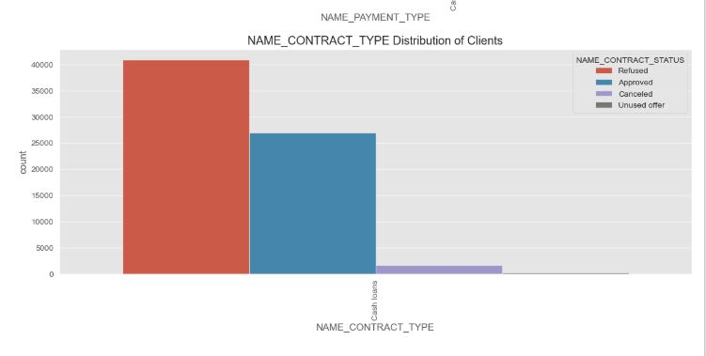
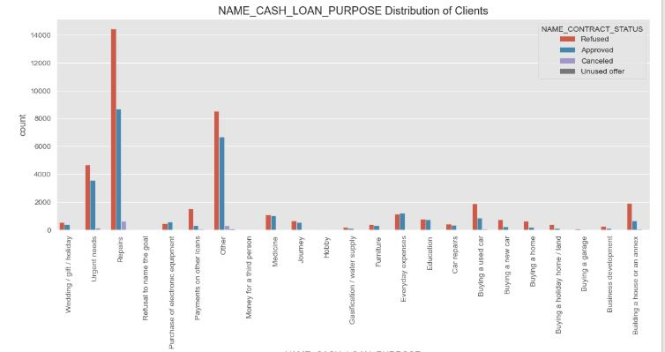
Previous Application Analysis:
In the approved category, consumer loan has larger number of applicants
There seem to be no cancelled loans in cash loan category than consumer
More cash loans have been refused than consumer loans The Bank has more repeaters in all approved, refused, unused, cancelled categories
POS transactions seem to be consumer loans and as started before more cash loans have been refused than POS
Repairs, other has the highest refusal based on the purpose of loans clients' request.

Slide 19
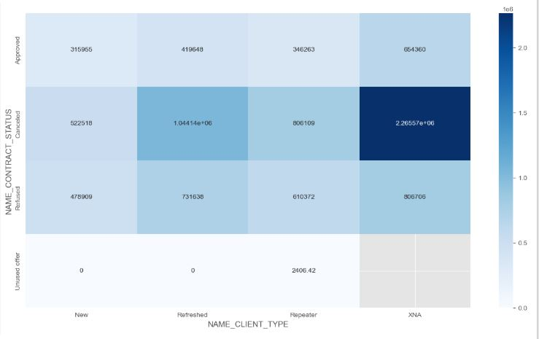
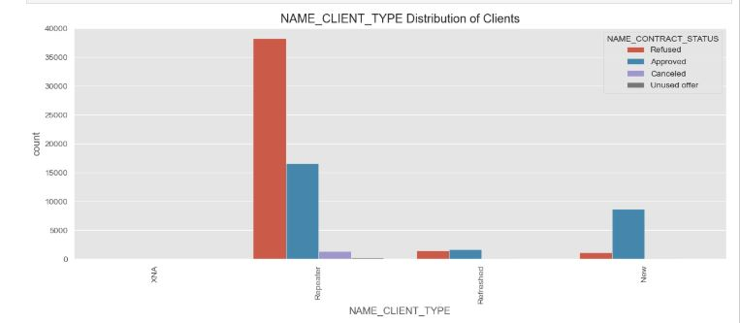
Previous Application Analysis
Unused offer CREDIT AMOUNT is low; This may be the reason for customer not using it.
Unable to understand why for cancelled and refused there should be any credit amount?
All cancelled and refused cases have higher value of application amount than other categories
Clients that repeat their application tends to have the highest number of refusal but are still considered for loan approval while new clients have the better chances of loan being approved.

Slide 20
Recommendation:
According to the EDA Analysis, Company should provide loans more for Office apartment, Co-op apartment, housing type as there are less payment difficulties.
Company should provide loans to Repairs and self-employed purposes
Company should provide loans to the Business Entity-3 and self-employed clients
working clients especially female employed are the best to target for loans than male.
Previous application with Refused, Cancelled, Unused loans also have default which is a matter of concern.
This indicates that the financial company had Refused/Cancelled previous application but has approved the current and is facing default on these. Credible applications are being refused.
Previous applications with Refused, Cancelled, Unused loans also have cases where payments are coming on time in current application. This indicates that possibly wrong decisions were done in those cases.

Slide 21
Conclusion
In this project, an insight into the credit risk analysis for the approval of loan in making decision using a data driven approach to establish defaulters and non – defaulters across all features.
Data quality assessment with boxplot to identify outliers and handling missing values was performed for better data structure and further analysis.
Exploratory data analysis and risk assessment helps to understand the key risk indicators, areas of concentration in regard to loan approval system and repayment strategies to adopt by Bank in the process of approving loans.
The analysis helps to make findings on defaulters on both previous and current applications to understand the targeted categories to offers loans.
Incorporating data driven insights, financial initiatives, and policies that adhere to regulations enhances portfolio management and promotes sustainable credit expansion.

Slide 22
Thank You !

